Slide 1
FORL 1060: Zasechnaya Cherta, Russia
Daphna Laveus
Lucas Meinken
Reena Patel
Cristian Rosales
Chelsea Silvia

Slide 2
Introduction
Zasechnaya Cherta loosely translated as the great Abatis line represents a chain of fornications from the 14th – 17th century.
The wall was originally created by Grand Duchy of Moscow as a protection from the Crimean-Nogai raids that ravaged the Southern provinces of Russia along the Muravsky Trail (Matranga et al., pg. 45).
Previously, the area on which the wall stood served as the borderline between the Muscovite state and the steppe nomads.
To serve its protection intent, the wall stretched for hundreds of kilometers.
The Abatis was built in 1566, but not guarded until the latter half of the 16th century, when the Crimean-Nogai Raids rapidly moved along the Muravsky Trail, ravaging the Southern provinces of Russia.”

Slide 3
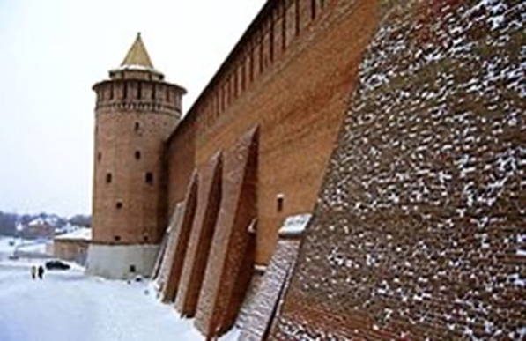
An image showing the Zasechnaya Cherta

Slide 4
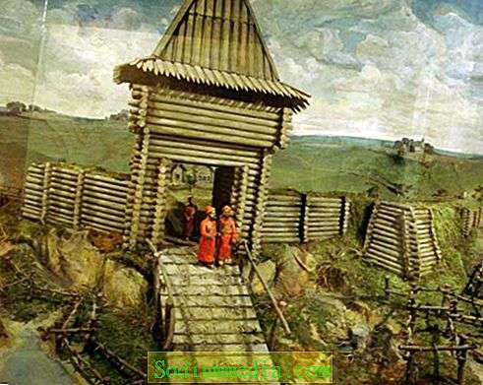
An image showing an artificial barrier

Slide 5
Abatis
Notably, Abatis is a military term referring to field fortification. It is essential to note that the wall was built using felled trees, purposely arranged to form a barricade.
Besides acting as protection against the enemies, the wall was also intended to provide a foothold in the attack on opponent (Hellie, Pg. 10).
Fortification of the Abatis borderline was done using earth mounds, palisades, watch towers besides natural features like swamps and lakes which surrounded the area.
Built using stacked up woods, the width of the Abatis extended for a couple of meters effective to withstand the arrows and spears from the observably skilled Crimean Tatars who were constantly invading the southern territories (15).
The population living nearby were not allowed to destroy the surrounding forests lest they exposed the fortification structures.

Slide 6
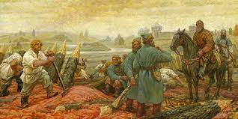
An artistic impression of the building of the Abatis

Slide 7
Size and advancement
Tellingly, as observed in various pieces research works, it is essential to understand that in areas that were presumed to be dangerous, the width of the Abatis was doubled or even tripled depending on the potential threats posed by the enemy (Khodorkovsky, pg. 250).
Those coming into the protected region were checked at the small wooded fortresses and gates. The gates leading into the protected area were made of massive folds of oak bound with glided copper plates.
Towers of up to 10 meters were built within the wall area particularly as a supplementary construction meant to watch and monitor the enemies. From such points any potential could be seen easily.

Slide 8
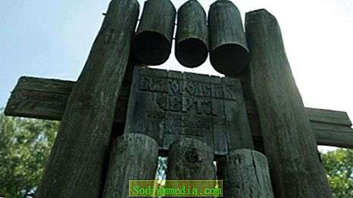
An image showing the gates of the fort

Slide 9
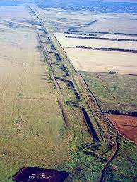
An image showing the stretch where the wall lay

Slide 10
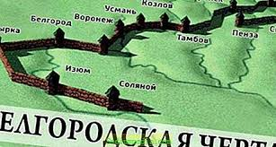
An image showing the structure and shape of the wall

Slide 11
Role of the Zasechnaya Cherta
In the ancient southern territories of Russia, Abatis lines were seen as efficient protection from the forays of the Crimean Tartars.
Forests and other natural features were considered natural obstacles from the enemies and for this reason, every effort was made to protect them (Matranga et al. 52).
Zasechnaya Cherta was adapted for gunnery and shooting.
To enhance its effectivity, stone and wooden kremlins were also included in the great Abatis border.
The fortification lines were built from felled trees laid down in a row with the sharpened tops directed outwards towards the enemy.
The resulting architectural work arguably provided a formidable tactical obstacle to the enemies and impeded the mobility of their arrows and spears.

Slide 12

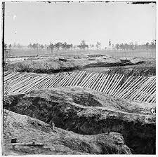
The wall’s primary focus was to defend as shown below

Slide 13
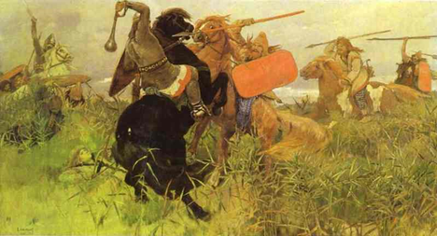
The wall impeded the mobility of horses, arrows and spears

Slide 14
Cont..
The wall was erected in 1560s.
Analogous to the great wall of China and Roman Limes, the Zasechnaya Cherta did not only provide a boundary demarcation but also provided an essential defense line between the settled agrarian society and the stateless nomadic Crimean Tatars.
The line was garrisoned with about 35, 000 soldiers manning the area. The local communities supported with renewing the fortifications.

Slide 15
Diminishing use of the boarder
Historians note that with the reduced conflicts and invasions, the use of the borderline began to diminish (Yakovlev, pg. 10).
It is noted that currently, there exists no trace of the border except for the natural vegetation that has taken over.

Slide 16
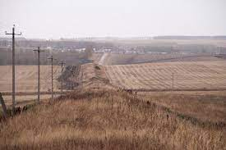
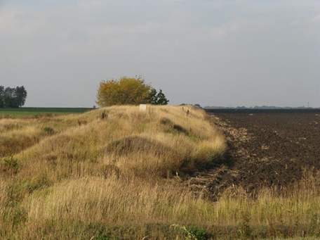
Images showing the landscape where the wall lay

Slide 17
Other significant border lines
To contain the raids a series of fortification lines was built along the southern frontier of the Russian state, starting from the mid-16th century.
The oldest significant line was finished in the time around 1563-1566 and exists from the Nizhny Novgorod along the Oka River to Kozelsk
This line was created by Ivan the Terrible.
The next notable line was built quite some time later and followed the line Alatyr – Orel – Novgorod Seversky – Putivl (Khodorkovsky, pg. 280).
Feodor I of Russia built the Abatis on the line Livny – Kursk – Voronezh – Belgorod.
The Simbirsk line was erected around 1640, which connected the Belgorod line from Tambov to Simbirsk on the Volga River.
In the year 1730/31, the Kama line disconnected Kansan from the Bashkirs

Slide 18
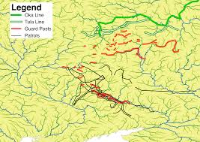
An image showing other essential lines in Russia

Slide 19
Explanatory video
https://youtu.be/NLweSJFUDFY

Slide 20
Works cited
Matranga, Andrea, and Timur Natkhov. All Along the Watchtower: Defense Lines and the Origins of Russian Serfdom. Mimeo, 2019.
Hellie, Richard. Enserfment and military change in Muscovy. Chicago:: University of Chicago Press, 1971.
Khodarkovsky, Michael. "Taming the" Wild Steppe": Muscovy's Southern Frontier, 1480-1600." Russian History 26.3 (1999): 241-297.
Yakovlev, A.I., Zasechnaja cherta Moskovskogo gosudarstva v XVII v., Moskva, 1916.

Slide 21
Image sources
“Great Zasechnaya Cherta.” Wikipedia, Wikimedia Foundation, 1 July 2020, en.wikipedia.org/wiki/Great_Zasechnaya_cherta.
Belgorod line: description, historical facts, creation. https://en.sodiummedia.com/4235069-belgorod-line-description-historical-facts-creation
Zasechnaya Cherta. https://alchetron.com/Zasechnaya-cherta

